Slide 1

Game Programming Shapes
Presenter: Tabish Sarfraz

Slide 2

Set of python modules
Cross-platform

Slide 3
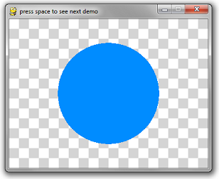
Circle
Surface
Colour
Location/Coordinates
Radius
Thickness

Slide 4
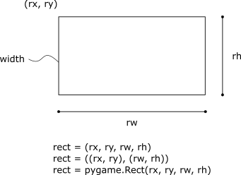
Rectangle
Surface
Colour
Rectangle
X,Y righthand side
Width
Height

Slide 5
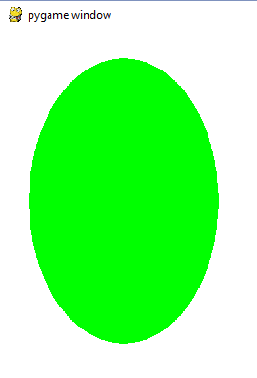
Ellipse
Surface
Colour
Rectangle
X,Y righthand side
Width
Height

Slide 6
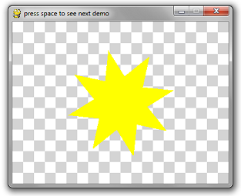

Polygon
Surface
Colour
Coordinates (x1,y1) (x2,y2) etc
Width

Slide 7
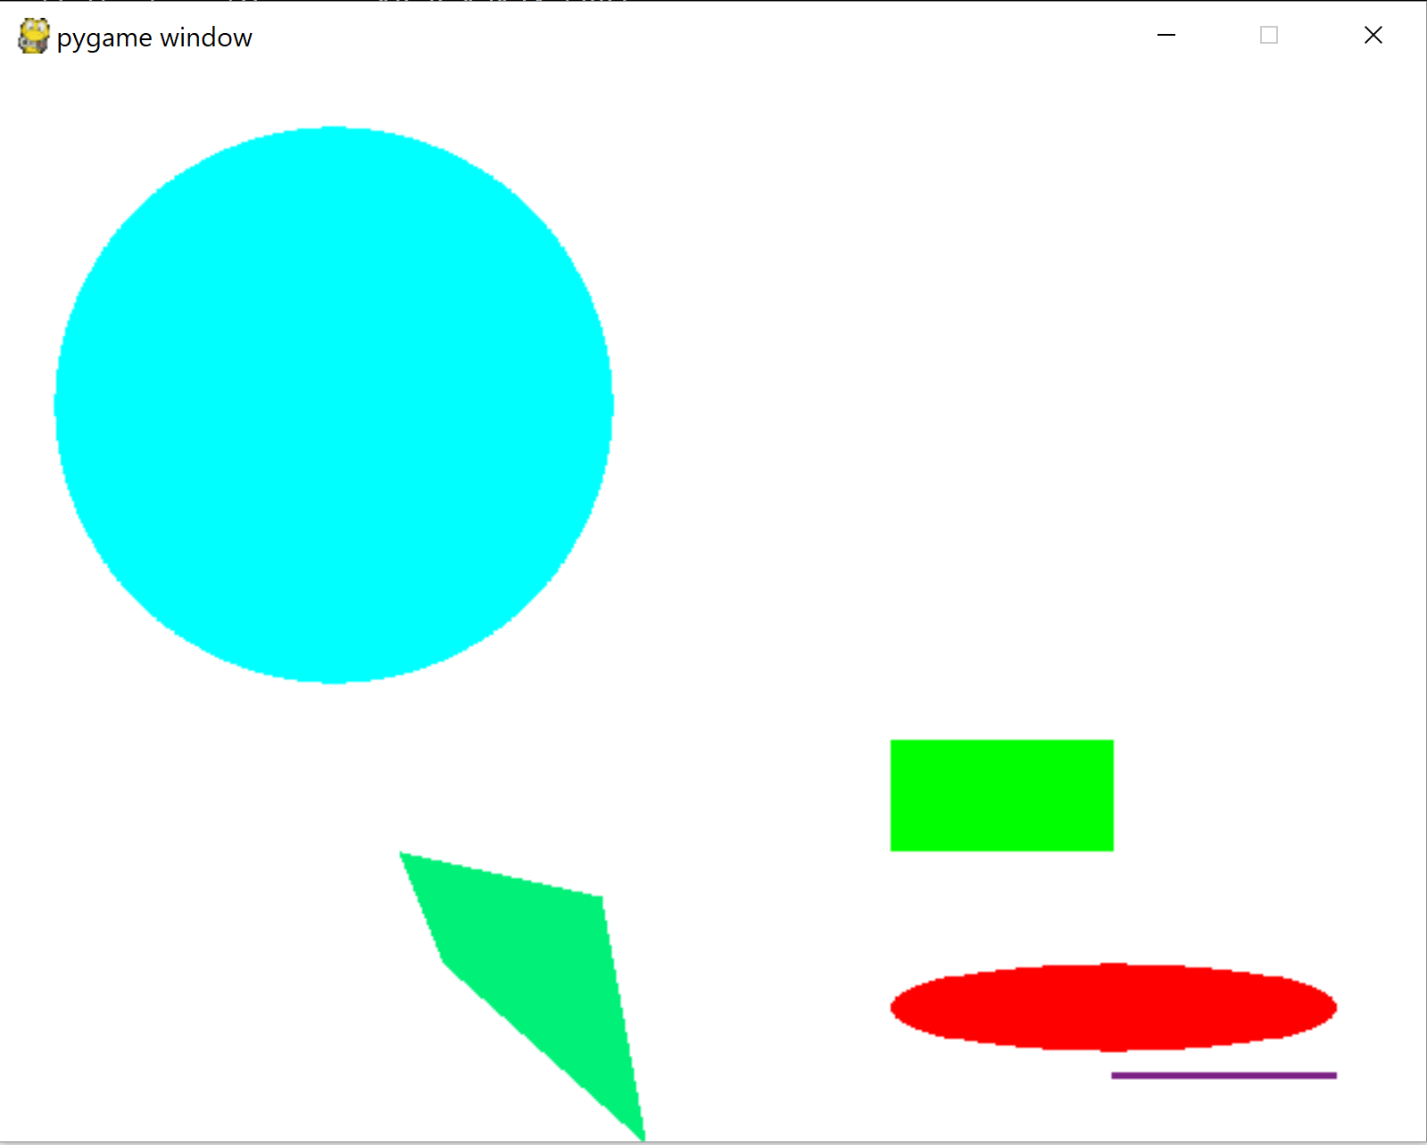
Examples

Slide 8
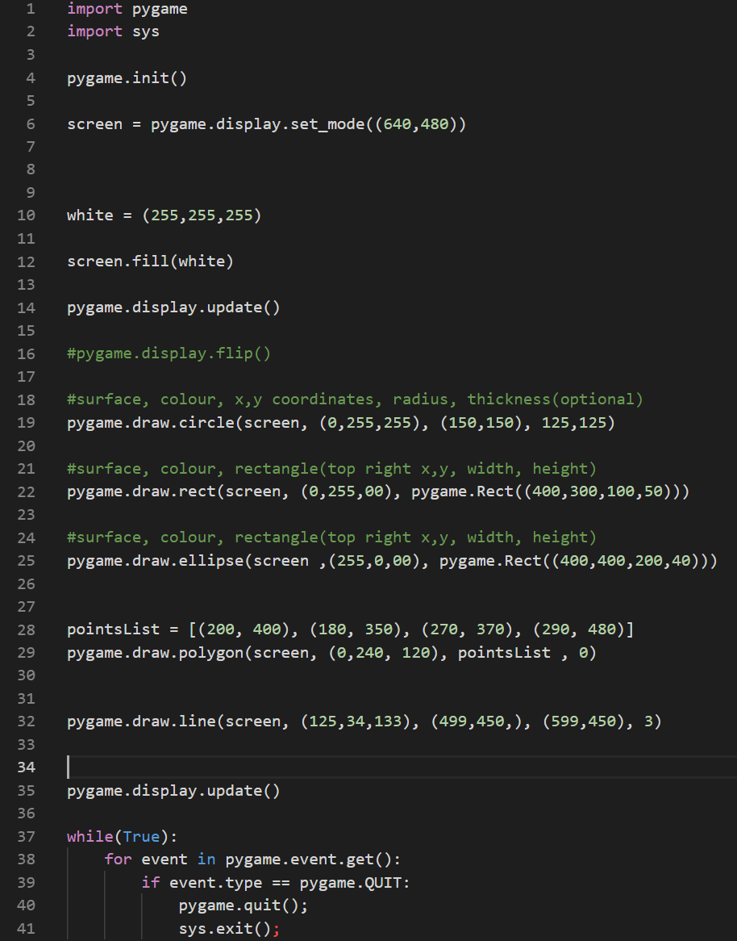
Code

Slide 9
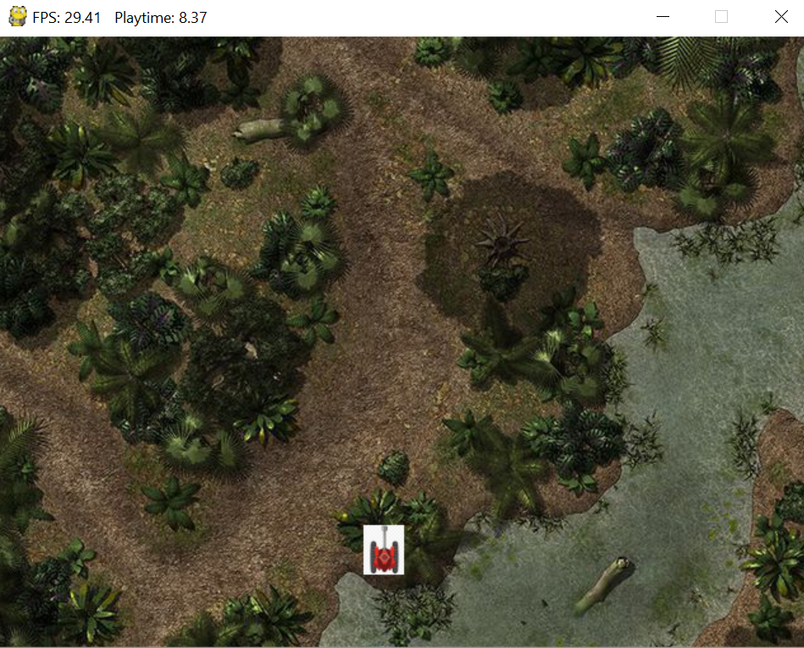
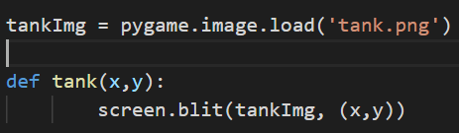
Image
Use .blit() on Surface
Provide image and coordinates of the image

Slide 10
Questions?

